Slide 1

Singleton Playground Project
July 2022

Slide 2
Project Overview
The Parish Council would like to create:
A community space where children can socialise, play and create a sense of belonging
Something that is accessible to the whole community so they can enjoy the open spaces
Provide a wealth of learning opportunities which benefit children socially emotionally, imaginatively and physically

Slide 3
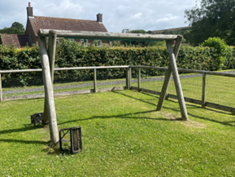
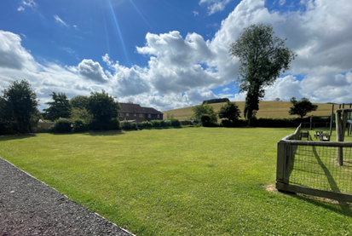
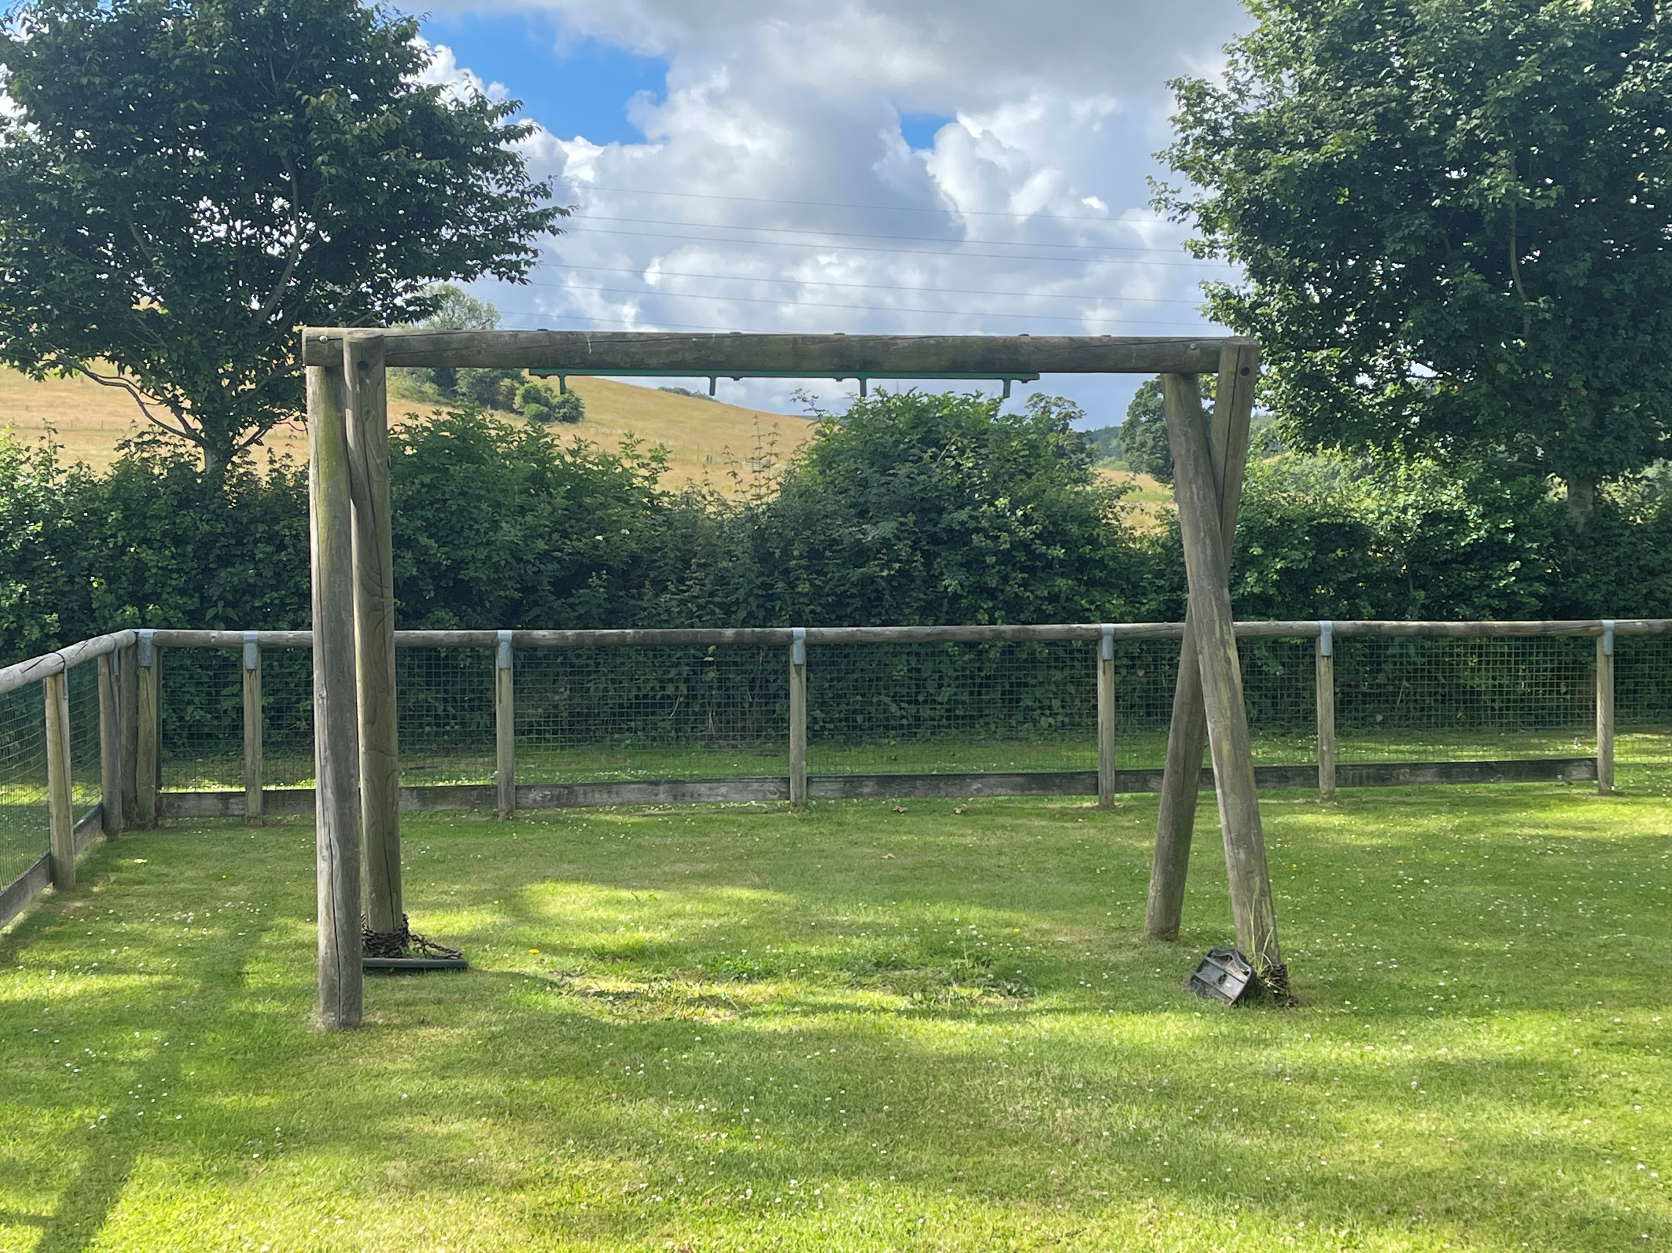
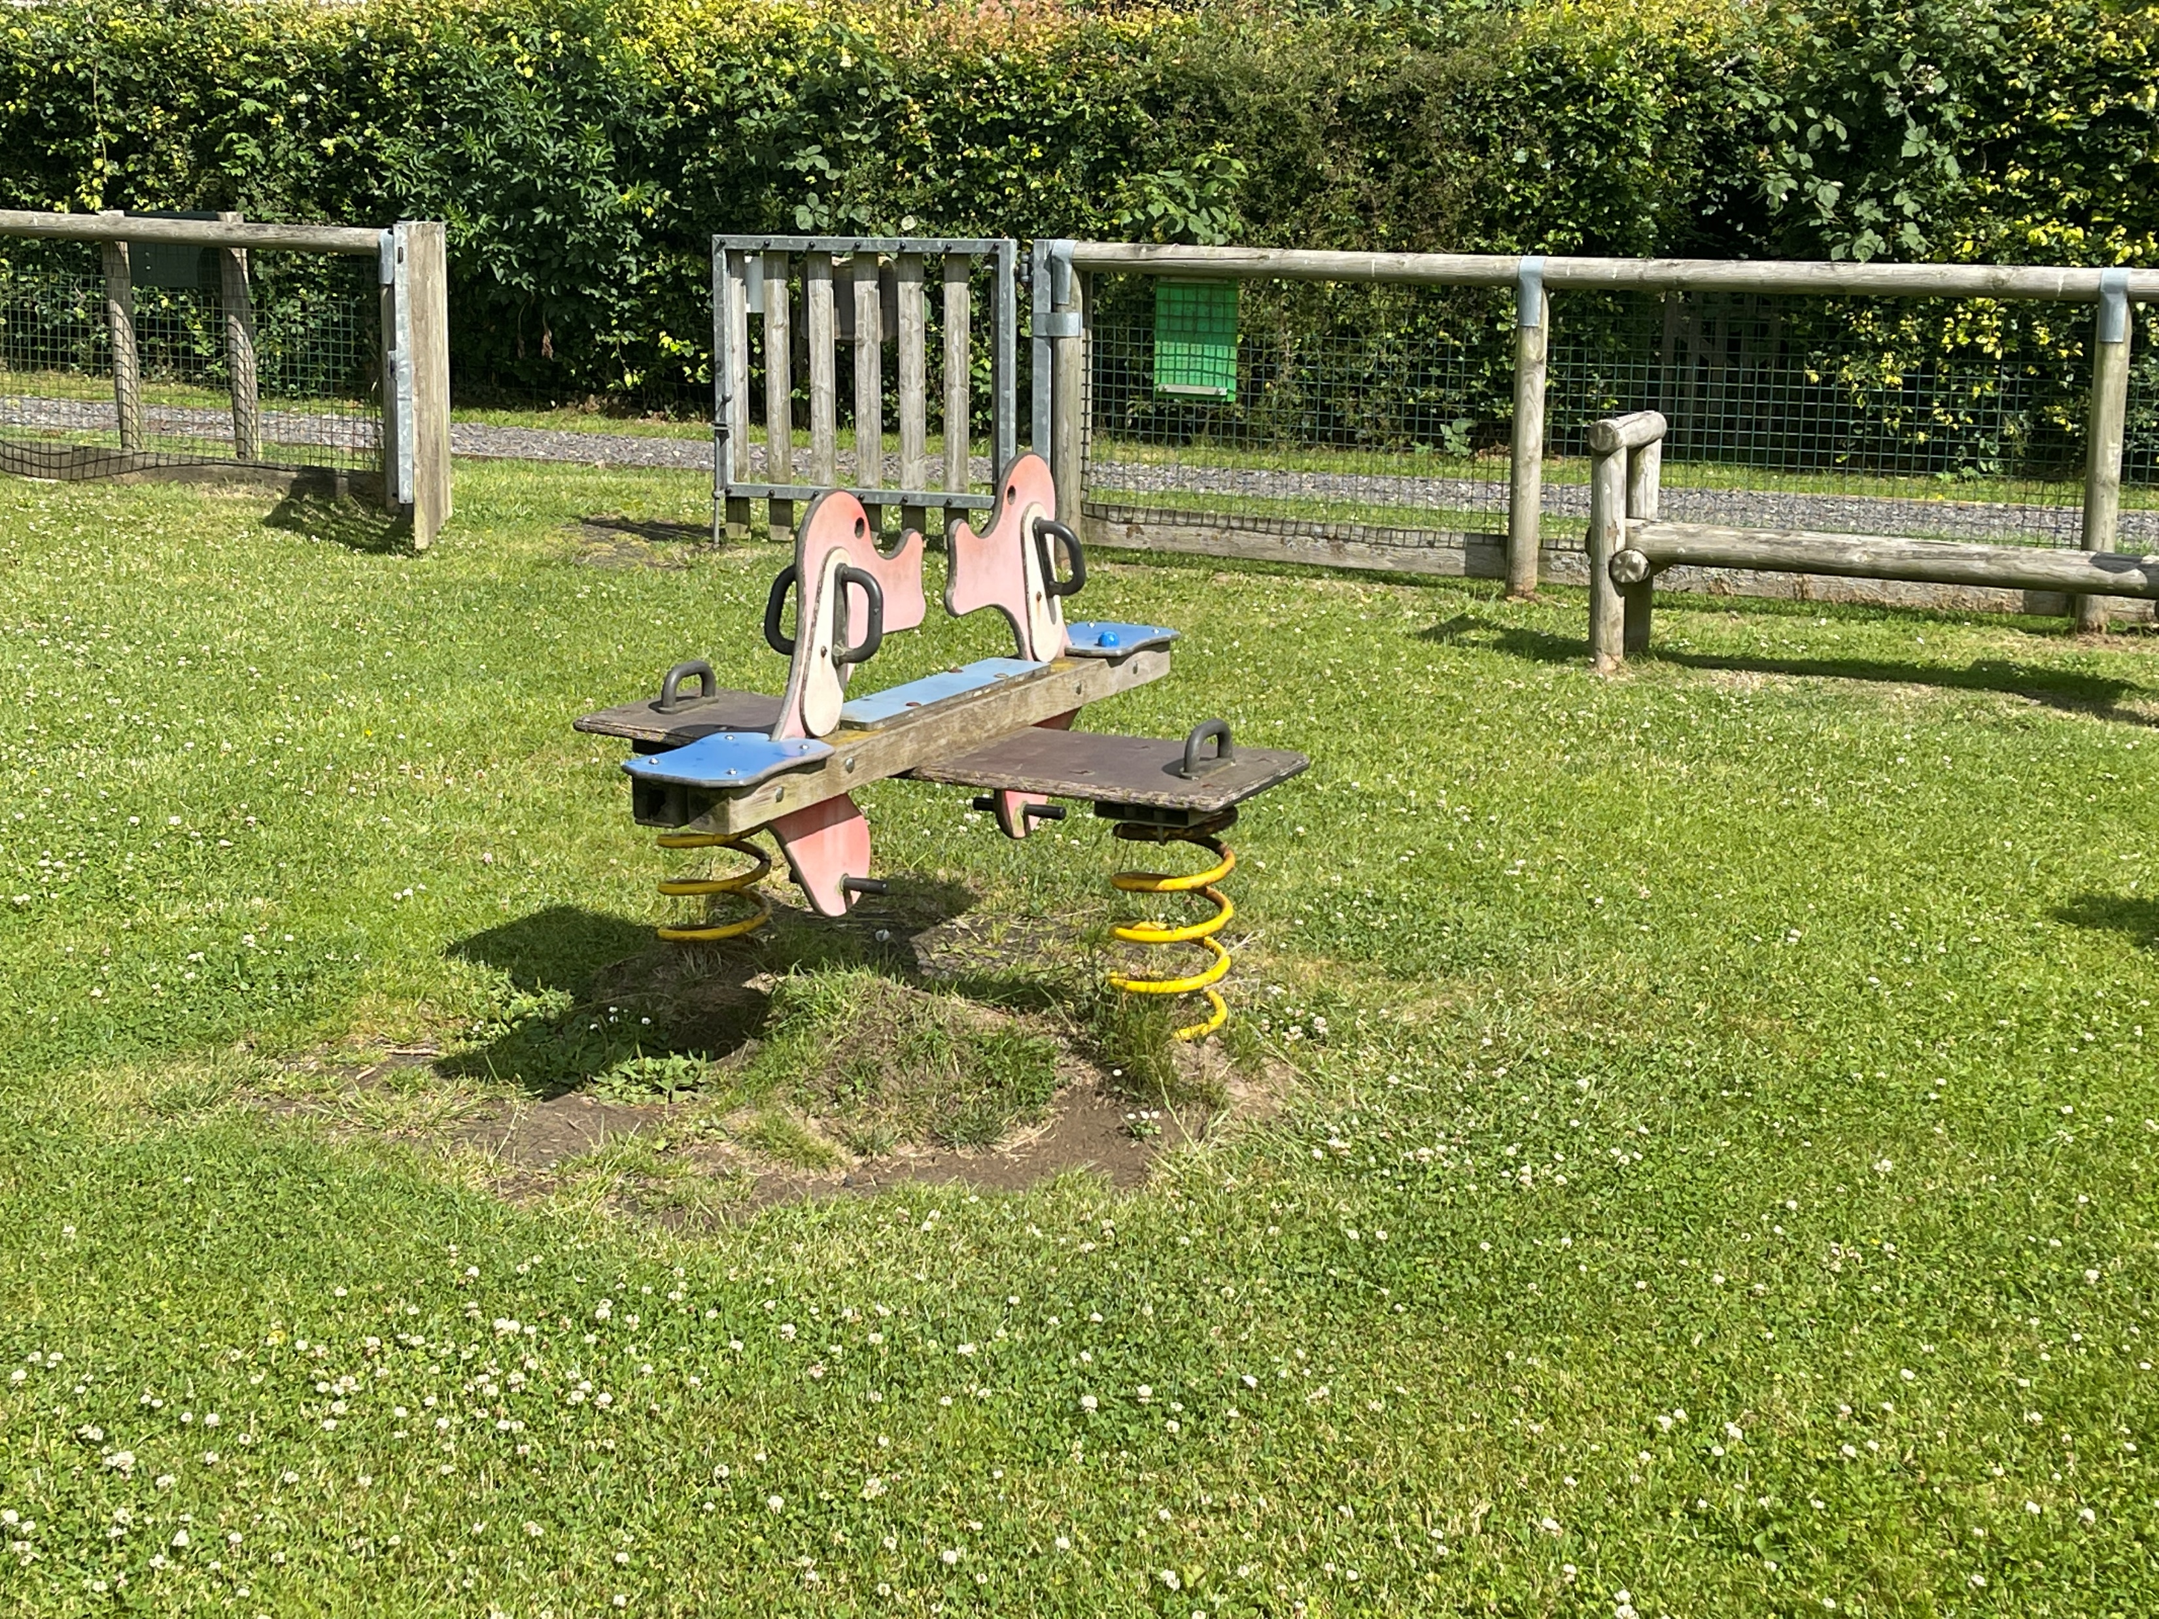
How our playground space currently looks – problems we face
No where for older children to play
Existing equipment in disrepair
Limited equipment available for younger children
No facilities for community gatherings
Lack of disability access

Slide 4
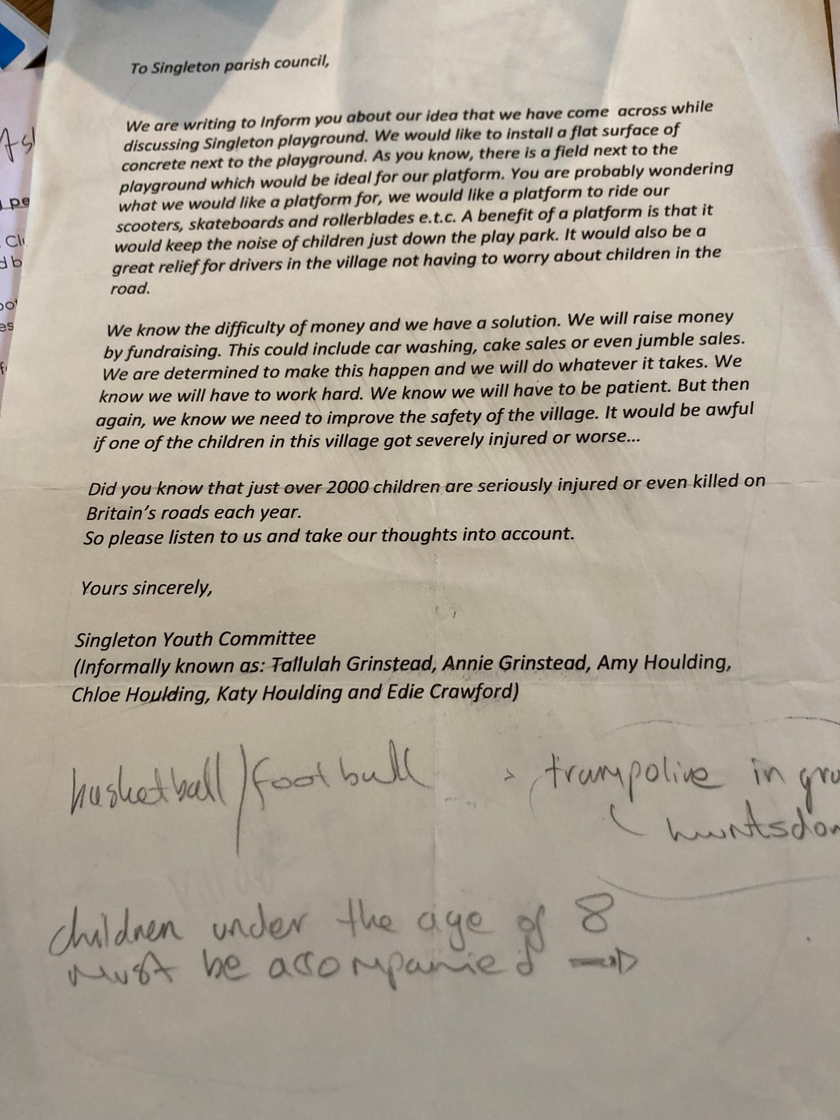
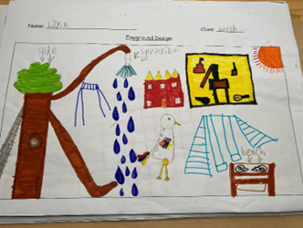
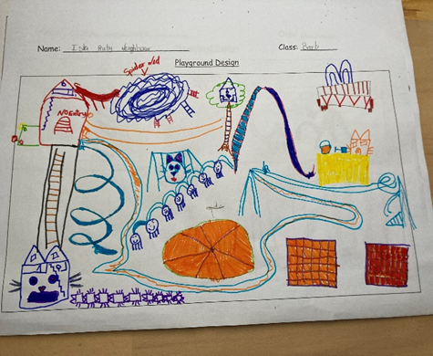
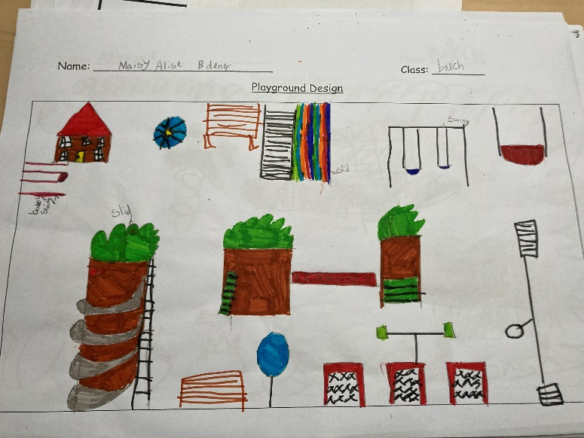
Community Requests
Village forum in 2019 – people asked for the playground to be updated
Youth community wrote a letter asking for equipment for older children
Singleton School ran a competition for design ideas

Slide 5
Playground Proposal
Phase 1
Replace the swings, install the football goal and basket ball net
Phase 2
Track, bounce area, picnic benches
Phase 3
New equipment for the playground: Trampoline, Roundabout, obstacle course

Slide 6
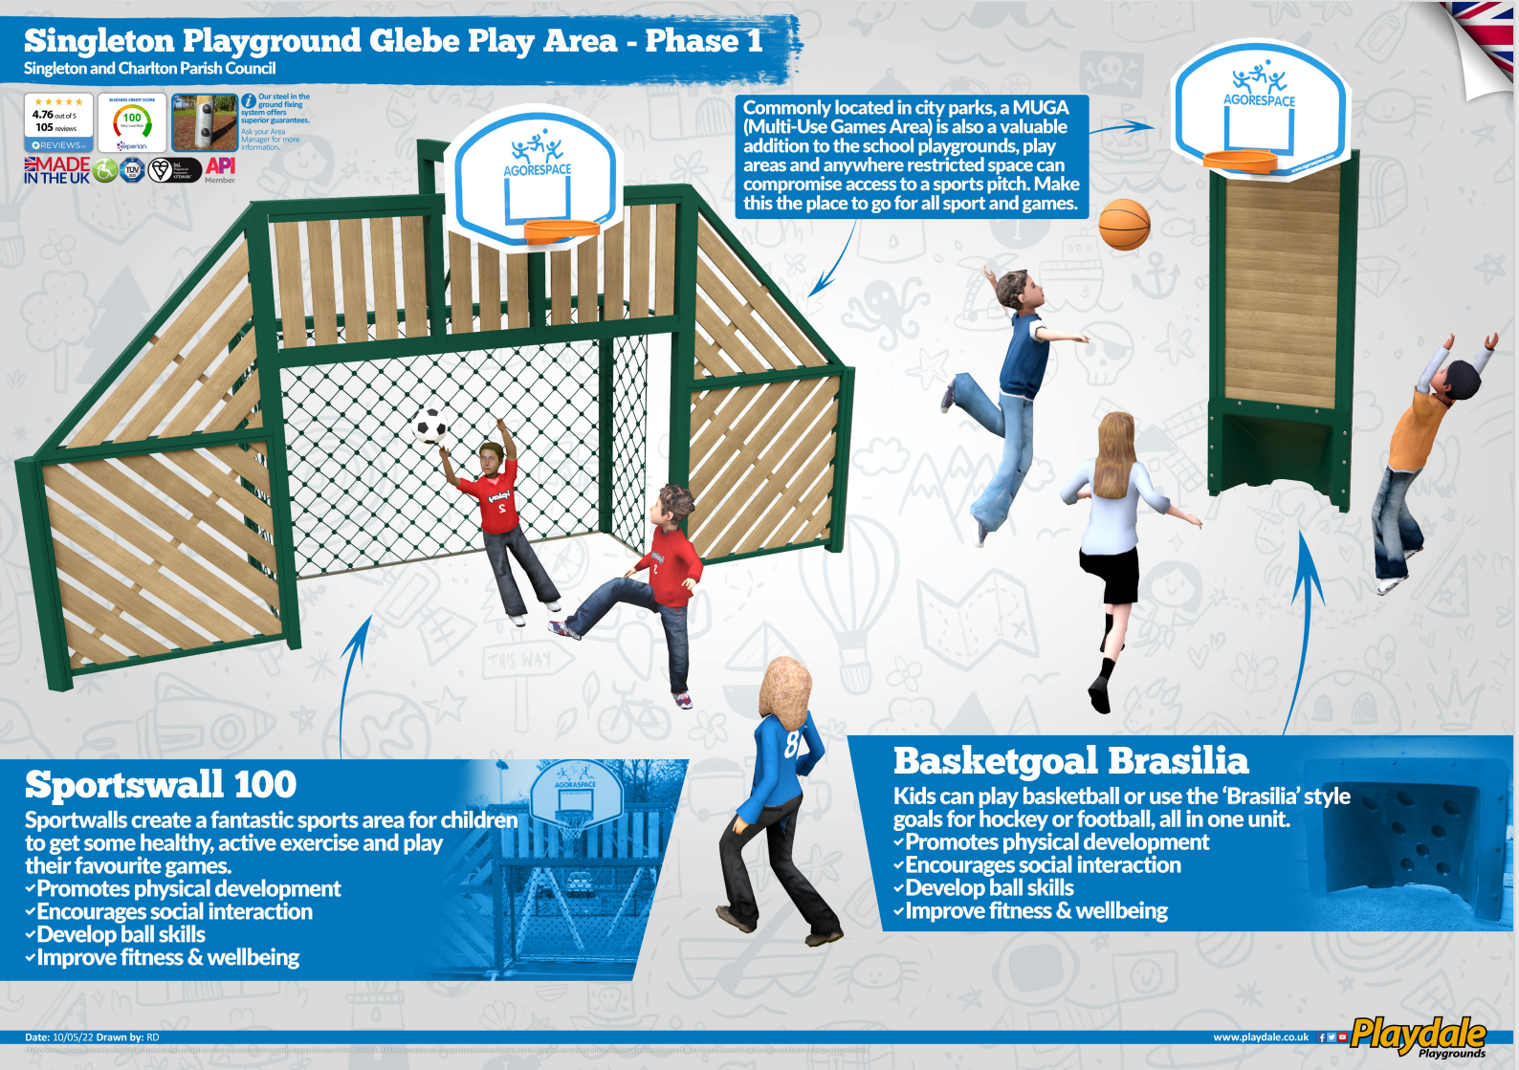
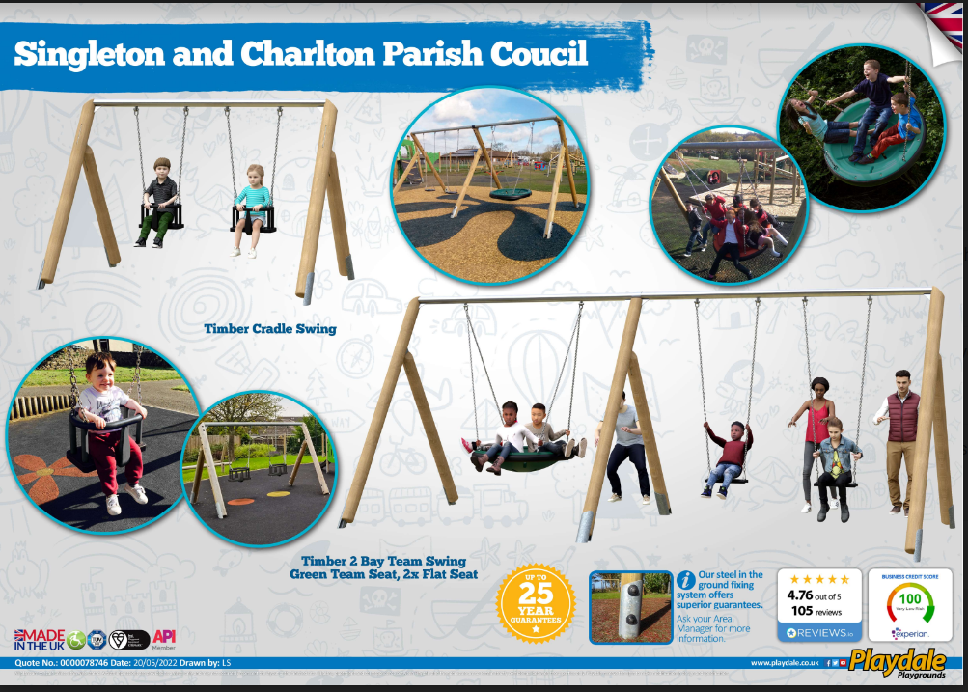

Slide 7


Funding
We need your support!
£10,000
Phase 1 – Complete and being installed at the end of the summer, we will keep you updated with progress
Phase 2 – Total amount to be raised £25,000
      CDC Grant application for £15,000
      Private donors / community need to raise £10,000 (see just giving to donate)
Phase 3 – Quotes currently being looked at
£5,000
£0.00
https://www.justgiving.com/crowdfunding/singletonandcharltonplayground?utm_term=dVKk9JAq2

